Slide 1
Ozone Pollution Observations and Studies in New York City Area
Mentor: Dingdong Li, Yonghua Wu
Optical Remote Sensing Lab, CCNY

Slide 2
Outline
Introduction
Research Questions
Instruments
Computer Skills
Research Outcome

Slide 3
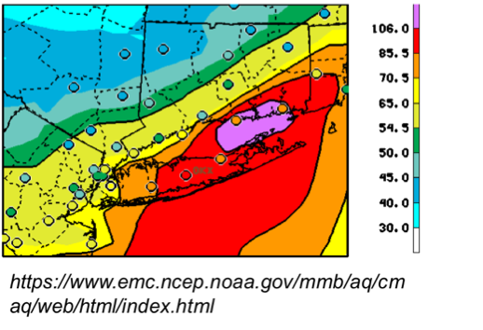
Introduction
Although the ozone in the stratosphere protect us from the UV radiation, the tropospheric ozone is harmful for people.
Long term exposure to ozone can cause and aggravates various lung diseases.
High ozone episodes are observed in New York City, especially during the summer.
Notes:
Ozone is one of major air pollutants that exceeds national ambient air quality standard (NAAQS) in New York City area on hot days in summer. This project will make use of optical remote sensing techniques and in-situ samplers to observe diurnal variation of ozone, NO2, smoke plume, and meteorological parameters. This project will provide the training opportunities on multiple instrument operations, observations, and data analysis at the Optical Remote Sensing Lab, CCNY.

Slide 4
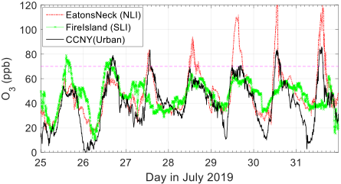
Research Questions
WHAT FACTORS AFFECT THE GROUND OZONE LEVEL?
WHAT IS THE FORMATION MECHANISM OF GROUND OZONE ?
WHAT IS THE TEMPORAL AND SPATIAL VARIATION OF THE OZONE ?

Slide 5
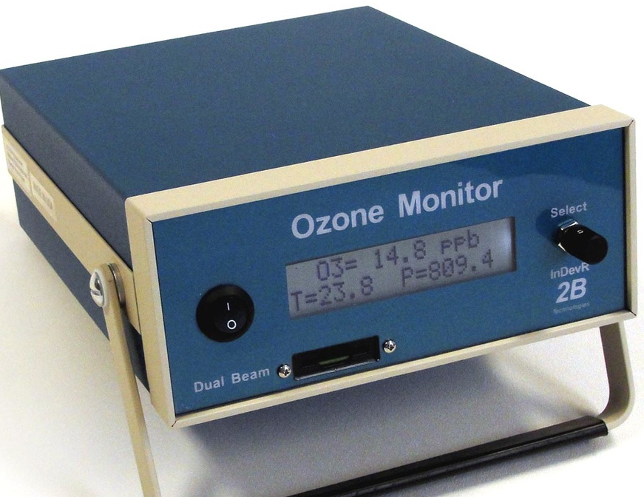
Instruments
In-situ ozone monitor
Weather Station
Ozone Differential Absorption Lidar
Aerosol Lidar & Ceilometer
Measure ground-level Ozone and other trace gases concentration.
Measure Ozone vertical profiles.
Measure smoke plumes, aerosol vertical profiles and boundary layer height.
Measure temperature, pressure, wind speed, wind direction, RH (relative humidity), etc.

Slide 6
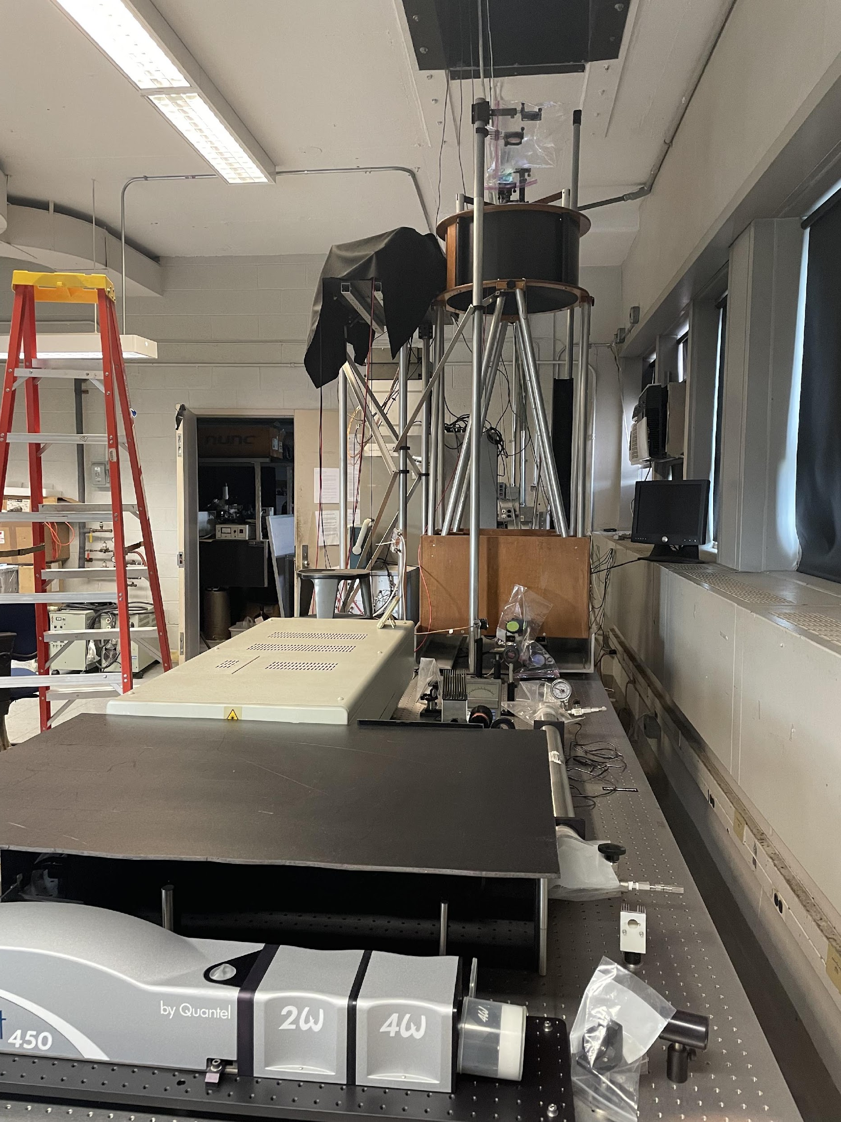
Instruments
Sun Photometer
Ozone & Aerosol Lidar System

Slide 7
Instruments
RESULTS OF 2022/04/29

Slide 8
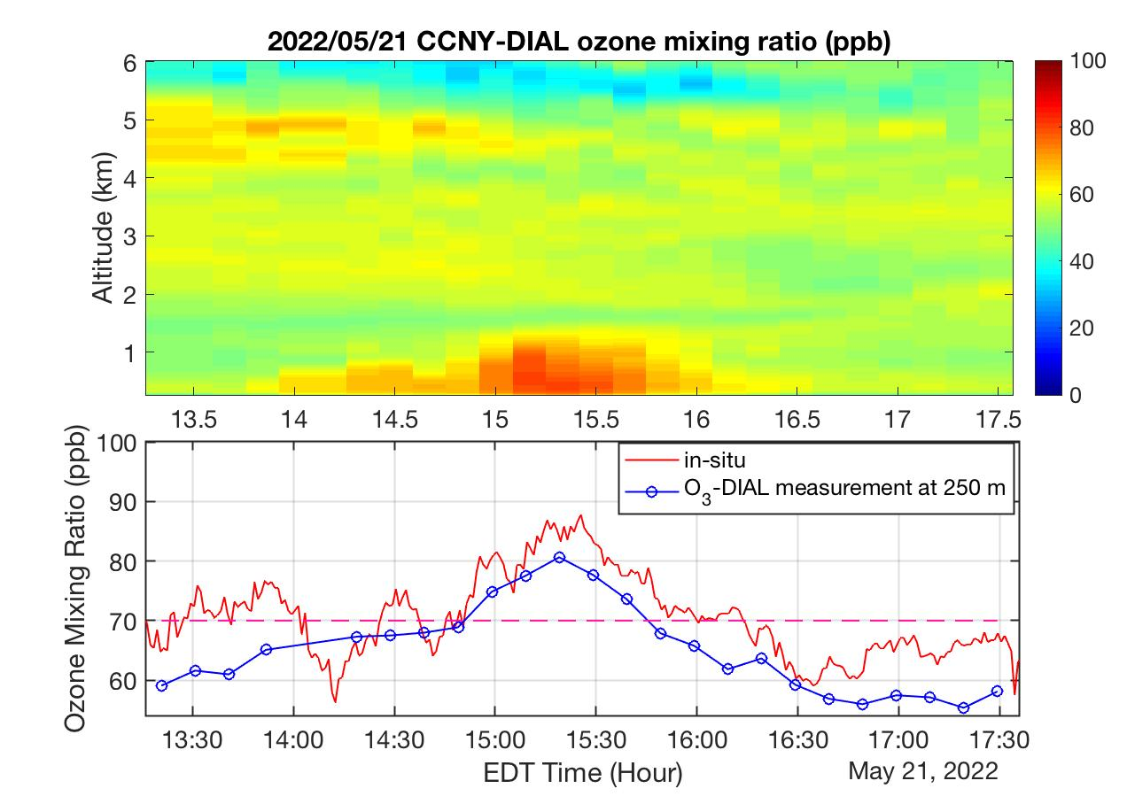
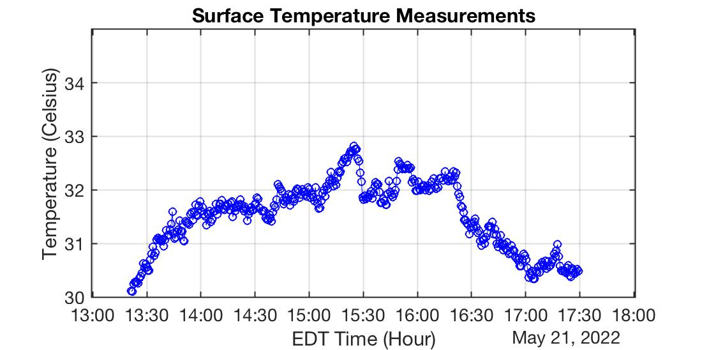
Instruments
RESULTS OF 2022/05/21

Slide 9
Computer skills
EXCEL OR GOOGLE SHEET
MATLAB
Required
Basic data analysis and visualization.
Optional but desirable
For advanced data analysis and visualization of lidar data.

Slide 10
Research Outcome
Deepen the understanding remote sensing applications in the air quality studies.
Training opportunities on multiple remote sensing instrument operations and observations.
Develop research skills: literature review, data analysis and visualization, communicating findings.
Have Fun!

Slide 11
Thank You
Dingdong Li
dli006@citymail.cuny.edu

